Slide 1
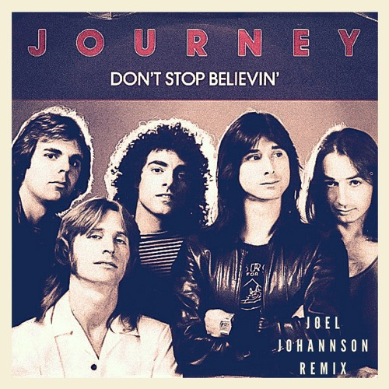
My ‘journey’ towards data skills
Philipp Bayer
@philippbayer@genomic.social

Slide 2
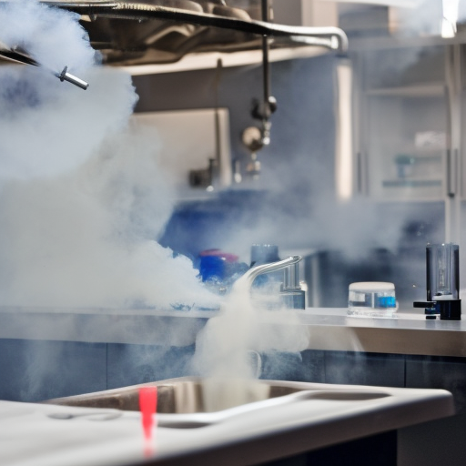
Who am I
Philipp Bayer, Undergrad in life sciences 2011 in Germany, PhD at UQ in applied bioinformatics in 2016. Then: Forrest Fellowship, DECRA, now working on ocean health with Minderoo Foundation.
Wanted to go into regular life sciences, BUT:
Let’s find out how I got from regular biology to here

Slide 3
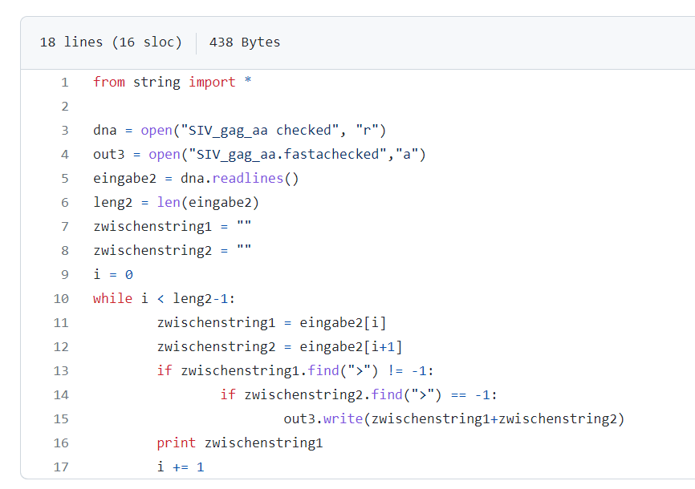
My journey since then
Started as a ‘meh’ programmer in biology, short scripts that did the job:
This is from 2008!!!

Slide 4
My journey since then
Kept on pushing myself: read books on programming, tried to think like a programmer in various languages, kept on taking on new (side)-projects in various corners that I had not explored before
Before I had kids, joined various meet-ups to learn from others
At some point, some kind of nirvana: no more fear of bioinfo projects. I can say ‘yeah i can do that’ and mean it (and later regret it)

Slide 5
My journey since then
After I felt comfortable in bioinformatics, branched out into more data science-y/machine learning-y things
At the time (2019?) it felt like the future of bioinformatics (a safe bet)
Went to PMLG meetups. Followed the ML people on twitter. Started ML-like projects in my work.
Left academia for many reasons in 2022. Now: ‘research officer AI’.

Slide 6
Lying to yourself
To get anywhere it is a good idea to trick yourself
Me in high school: I am not good at maths. Result: worst in class.
Me in uni days: ‘ah I’ll just lie to myself. I’ll pretend i’m good at it. fake it till you make it!’
Make your own fake news and repeat until you believe it (see: ‘illusory truth effect’)
Has helped me astonishingly well.

Slide 7
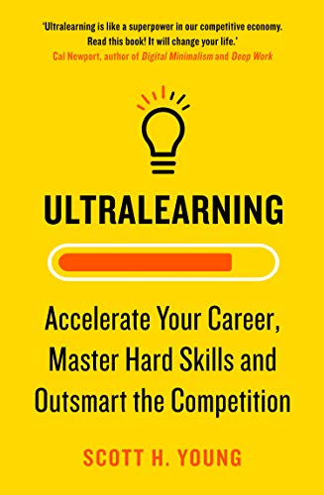
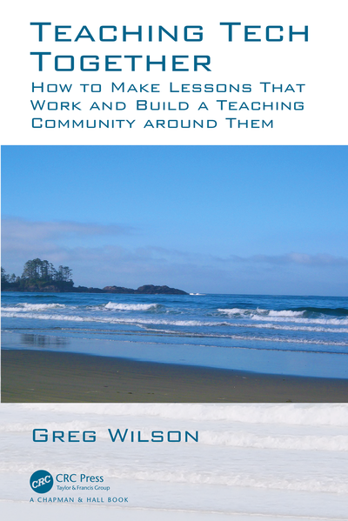
Better learning
Learning stuff is hard
Large amount of literature on how to learn, but none of it is taught in schools or unis (at least, to me)
Learning stuff well is harder
Measurable outcomes. Not just ‘learn Python’, but ‘understand and implement specific analysis ’
Brutal feedback and honesty: don’t lie to yourself (here)
Deliberate/reflective practice. Have a plan; continuously reflect what works, what doesn’t, change learning plan

Slide 8
Learning by doing
Learning by doing has always worked best for me. I vastly prefer building something in a language than reading the book on that language.
The upside of learning data/computers: you don’t need a PC2 lab to do cool stuff!
You can build a todo list program, or write up a simple analysis, today

Slide 9
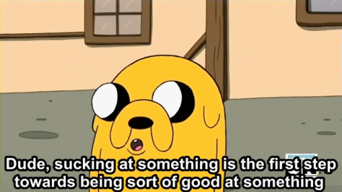
Embracing being terrible

Slide 10
Embracing being terrible
If you grew up being ‘the smart kid’, it’s hard to be bad at something. You see yourself as being good at everything, auto-magically.
In the worst case, you don’t do ‘new’ stuff because you might be bad at stuff. And that’s not who you are!
Letting go of that concept is hard!!! Works better when you’re secure in who you are, and that needs a lot of work on yourself
Leaning into discomfort is a learned skill that I constantly unlearn. Wet socks forever

Slide 11
Don’t go the distance alone
In programming, you’ll get many error messages like ‘object of type closure is not subsettable’. Or it won’t run because you didn’t close a bracket somewhere. I believe this kind of nonsense is the biggest reason why people stop learning how to program.
Everyone suffers because some guy in 1974 decided this is how it’s going to be. You’re not stupid, it’s that guy’s fault
The best way to go forward: Get together in groups, have a regular time together!

Slide 12
Don’t go the distance alone II
Start a Hacky Hour (-> @HackyHourUWA). Pester your postdocs, they won’t mind, they don’t want to write that paper anyway.
Go to meetups, or start your own (Perth Machine Learning Group, for example).
Somebody somewhere has solved the problem you’re having
Surround yourself with people who have the same problems as you, or are now where you want to be
Follow those people on Twitter/Mastodon/Fediverse
We are a product of our surroundings

Slide 13
You have the world as your helper
For data science/machine learning etc. learners, you have a world of resources at your hand
For DS/ML: Kaggle. A community of practitioners, lots of small and big datasets plus competitions to get your hands dirty – a WEALTH of others’ notebooks to learn from
For R: RLadies, Tidy Tuesdays.
For ML: There’s fast.ai (PMLG!), there’s Karpathy’s Zero to Hero

Slide 14
Choose your surroundings wisely
Some computer-people have an ultra-negative outlook
‘This code is terrible’, ‘this is all garbage’, ‘this is ugly’, etc. pp.
In my early days I used to be like that!! And I have worked with too many people like that, and I have never ever ever learned anything from them
On the contrary, positive people always had something cool to teach me! Perhaps the negativity is a defence mechanism for many. I don’t know. Cover up your deficiencies?
BUT: There’s nothing to be gained that can make it worthwhile to stay around these people. They might sound impressive but it’s all smoke and mirrors. They will just drag you down.

Slide 15
Final things
We should never have invented computers
You’re not stupid, the language’s mental model is not yours (yet ☺ )
Don’t get intimidated by complicated words or terminology, it’s mostly smoke and mirrors (example: rectified linear unit activation function ReLu)
‘Genius’ and ‘talent’ are comforting myths
Learn from the magicians:
believe

Slide 16
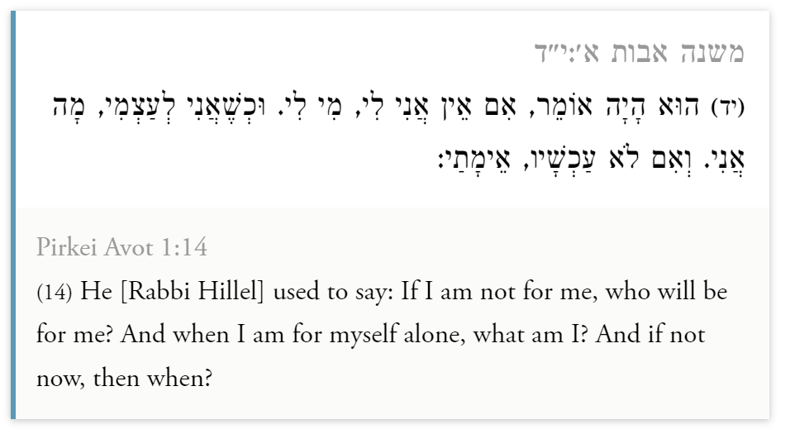
Final final thing

Slide 17
My ‘journey’ towards data skills
Philipp Bayer
@philippbayer@genomic.social

